Slide 1

ECE 337 Project Bitcoin Miner
Team Members:
Andres Avila, Michael Loh, Lalit Sudarshan and Nikhil Ghanta.

Slide 2

Project Overview
Bitcoin – cryptocurrency
Bitcoin mining – verification of transactions
Transactions are pulled from a mining pool
Verification done via SHA 256 hashing
Each verification earns bitcoins and increases security of the pool
ASIC application ensures profitability of mining

Slide 3
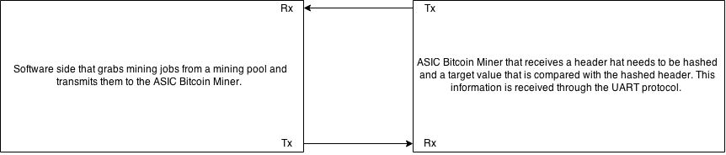
System Level Diagram

Slide 4
System Design Operation
No
Has data transmission finished
Is the hash sum less than the Bits value?
Yes
Yes
ASIC is IDLE
No
No
Is there new work
No
Prepare nonce and correct hash for UART transmission
Is there new work?
Yes
Yes
Concatenate new data into a data block and unpack bits
Generate new nonce and append to data block
Hash data block with double SHA-256

Slide 5
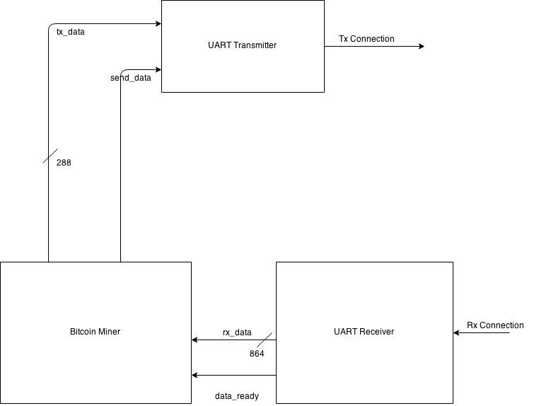
Design Architecture

Slide 6
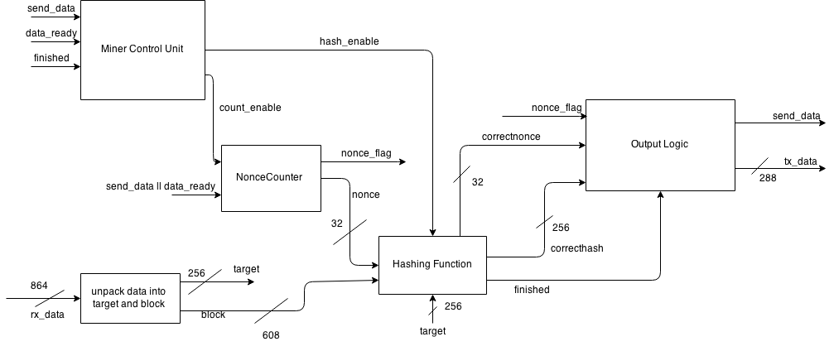
Miner Block Overview (RTL)

Slide 7
Fixed Success Criteria
Test benches exist for all top level components and all of the functional requirements have been tested properly.
The top level components synthesize completely without any warnings except for some small metastability in the output.
Source and mapped version of the complete design behave the same for all test cases. The mapped version simulates without timing errors except at time zero: Source and mapped versions of the design behave identically without any timing errors.
The IC layout for the top level design is work in progress and will be complete by the time of the demo.
We are in the process of coming up with the IC layout. The estimated design area we calculated at the time of the design review was 25,066,819.48. The design compiler reports an area of 47159037.0. From our design review, our target clock period was 20ns. Our design works effectively with a 10ns clock period.

Slide 8
Design Specific Success Criteria:
The UART Receiver works as expected and the UART Transmitter is still a work in progress.
The SHA256 block successfully performs one run of the SHA256 Hashing Algorithm.
The Individual Mining Core Unit performs a complete hash given a block of 640 bits.
The hashing function block has been successfully tested with N number of cores to see if it finds the correct output with a scalable amount of cores.
The top level miner block has been tested and it exhaustively tests nonces to find the correct hash and when it finds it, it correctly asserts the send_data signal.
The test bench checks the ability of the miner to start a new job successfully when new data is received, even if it was processing other data.

Slide 9
Miner Top Level Block Layout
Synthesis Critical Path Delay: 7.68 ns
Timing Budget Critical Path Delay: 17.3 ns
Total Cell Area: 47159037 um^2

Slide 10
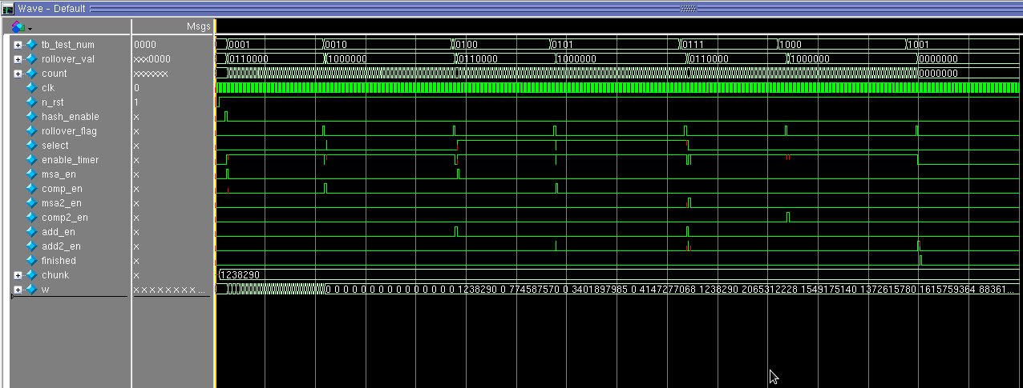
Test Results
First major round of testing was for verifying that the control unit for the mining core operates correctly.
select = 1 after the first chunk is processed to select the second chunk
finished = 1 after add2_en
hash_enable = 1
and msa_en = 1 is asserted afterwards
(for 1 clock cycle)
comp_en = 1 after
rollover_val is changed
add_en = 1 is asserted after second chunk and msa2_en = 1 to enable second round of hashing

Slide 11
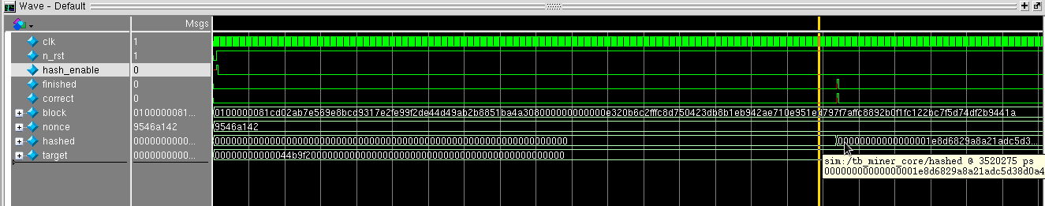

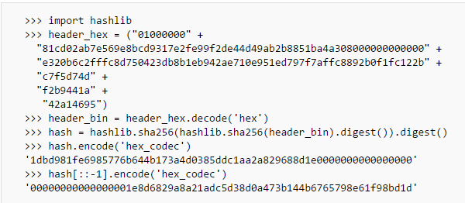
Test Results
Second major round of testing involved verifying that the hash output from the core is a valid SHA-2 hash.
Nonce = 9546a142
(Big Endian)

Slide 12
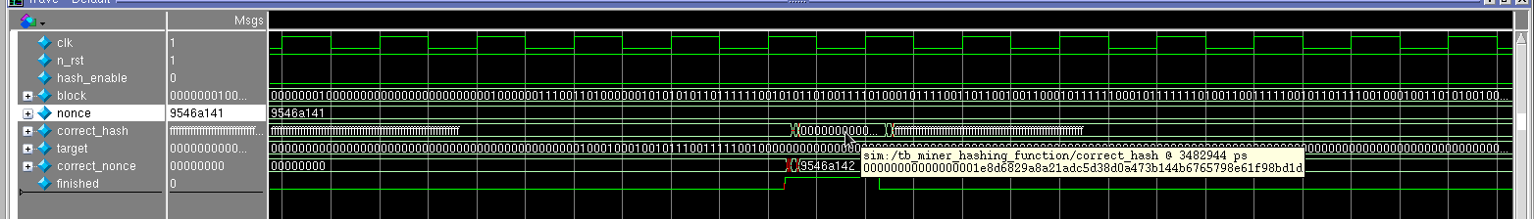
Test Results
Third major round of testing involves verifying that the miner operates successfully with multiple nonces from multiple cores
Nonce = 9546a141
(Big Endian) is passed into miner, and then passes Nonce + 1 and Nonce +2 to the other cores
Nonce + 1 = 9546a142
Is identified as the correct nonce
Correct_hash is correctly asserted to all F’s after data is finished sending and a new block is ready to be processed

Slide 13
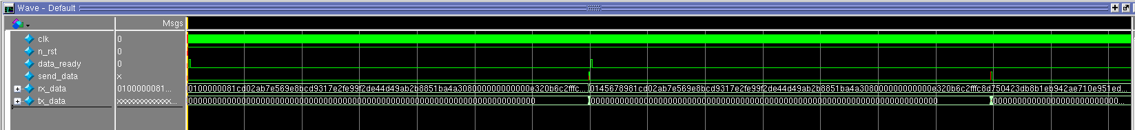

Test Results
Fourth major round of testing involves verifying that the functions of the miner (top-level functions) work properly.
Send_data is asserted correctly after it detects that the hash is valid for the current target. (The target is extremely high, so even the first nonce will generate a correct hash)
Send_data is asserted correctly again as a new block is processed along with another extremely high target to ensure success on the first nonce
Correct_hash is correctly stored in the tx_data buffer
when after send_data is asserted

Slide 14
CONCLUSIONS
BIGGEST CHALLENGES FACED:
Major challenges were dealt with while testing our design.
Checking and verifying our hashing algorithm outputs with the results from the SHA256 online calculator using pre-tested data.
Identifying the smallest difference in our 288 bit output with the expected result and modifying our hashing algorithm relatively.
CHANCE TO DO IT ALL OVER AGAIN?:
Spend lesser time deciding to prioritize area or speed and focus more on optimizing speed since that’s the main goal of a Bitcoin Miner.
Implement a different protocol(I2C) for receiving and transmitting the data to receive a quicker transaction approval.
GIVEN MORE TIME?:
To obtain a faster output we would alter our design and work on processing multiple nonces at once.
We would pipeline our design to achieve a faster and more process efficient output.

Slide 15
THANK YOU!

Slide 16
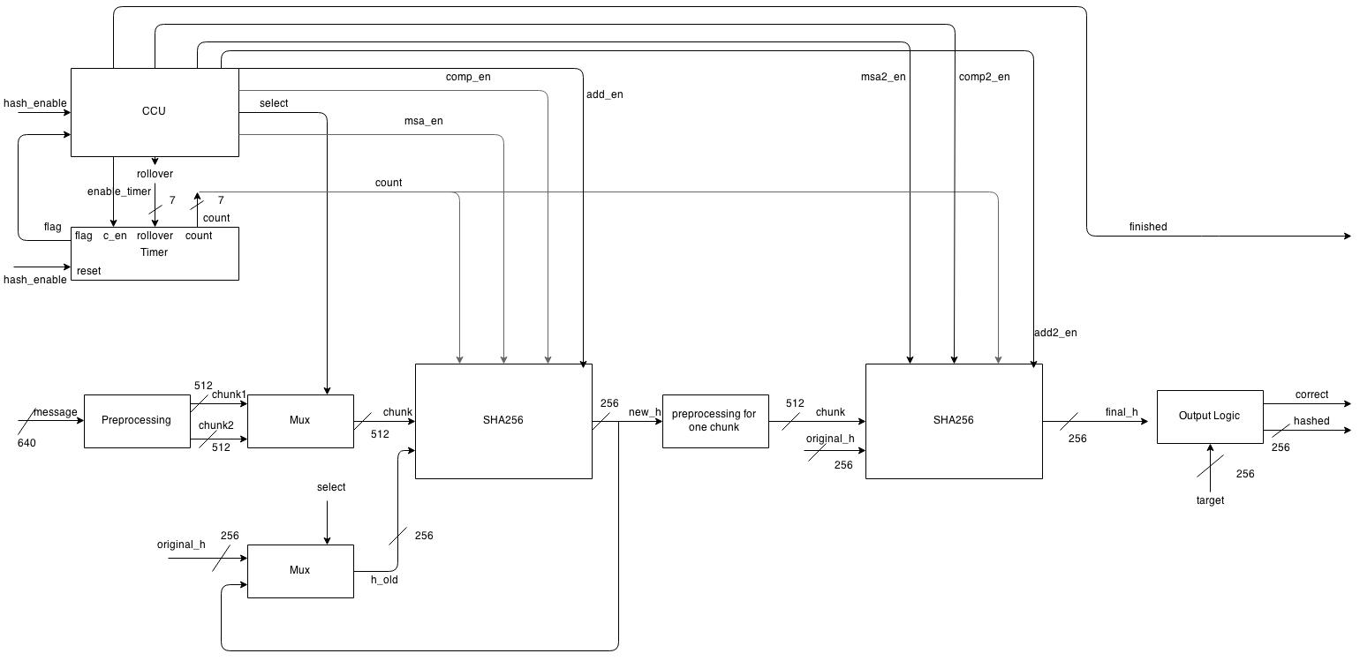
Mining Core(RTL)

Slide 17
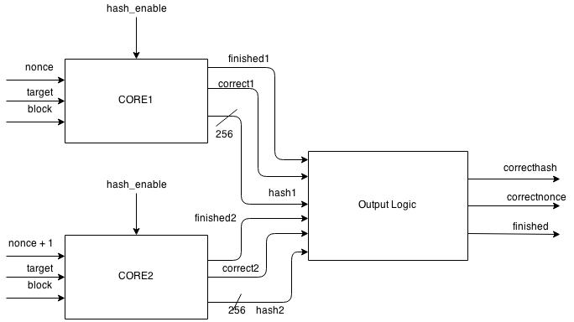
Mining = Hashing + Verification

Slide 18
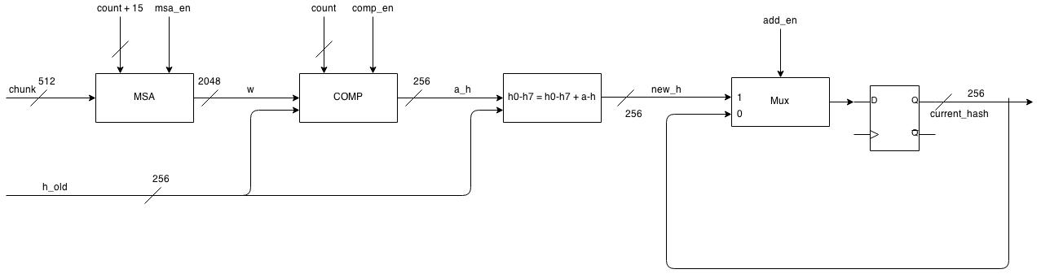
SHA-256 Encryption

Slide 19
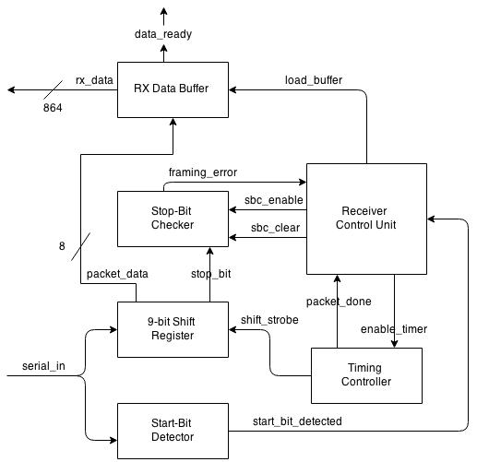
UART Receiver(RTL)

Slide 20
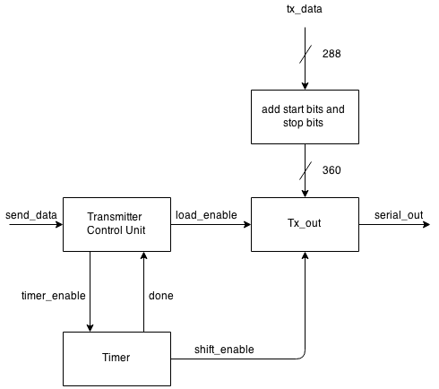
UART Transmitter

